Slide 1
DevOps

Slide 19
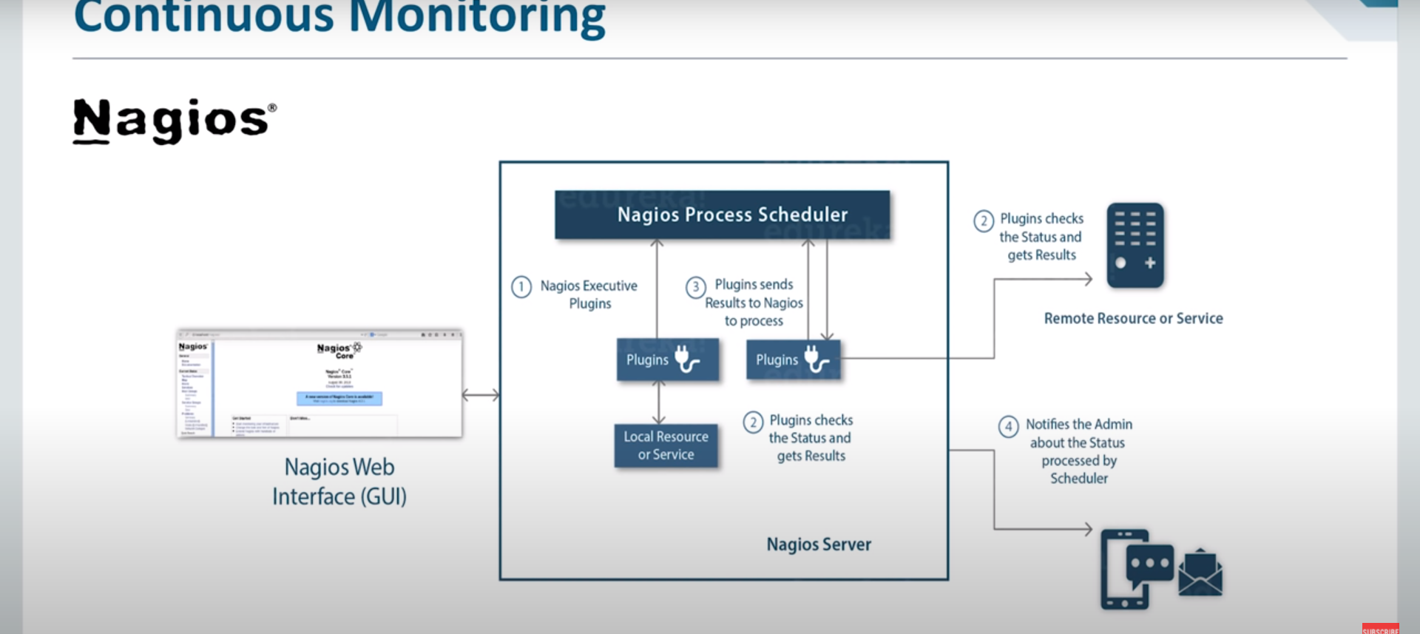

Slide 21
Notes:
Containerization is a process in which we make containers
Containers are light weight alternatives of Virtual Machines
A docker container contains all the binaries and libraries to run an application
In case of microservices, if we need 5 services , we can store them I n 5 different containers and then we can communicate between them
Whenebver you want to containerize an applicatin, we ue docker file
Docker file cibtrains all the project code
When you build docker file, it becomes docker image
Ans when you run a docker image, it becomes docker container
Yu ca use thid coekcr image anywhere, we can distriute thio uimage to all debellopers in theteam in production env or testing env
Docker container is a running instance of a docker image
We can store al the docker imaggs in docker hub
Docker hub is a repository to store docker iages
Images are downloaded in two ares
Atging Server and productopn serever

Slide 23
Docker

Slide 24
What is Virtualization?
Process of running multiple virtual resources on top of a single physical machine. These resources can be storage device, network or even an operating system.

Slide 25
Problems before Virtualization
Buying servers was expensive
Resources were not being utilized at their full potential

Slide 26
After Virtualization
Windows and Ubuntu OS now are running on the same server in parallel using Virtualization.
This results in better CPU utilization and cost savings
Reduced spending
Process of getting software up and running is shorter
Easier backup and disaster recovery is available

Slide 27
Containerization
OS-level virtualization method used to deploy and run distributed applications without launching an entire virtual machine for each app

Slide 28
Problems before Containerization
Developers when run the code on their system, it would run perfectly, But the same code would not run on the operations team’s system
VMS took too many resources to run
VMS were too big in size to be potable
VMS are not developer friendly

Slide 29
With containers , all the environment issues were solved. The developers could easily wrap their code in a lightweight container and pass it on to the operations team.
Containers are not resource hungry
They are lightweight and this portable

Slide 30
Containerization Tools

Slide 31
What is Docker
Docket is a computer program that performs operating-system level virtualization also known as containerization.
First released in 2013 , developed by Docker, Inc.
Used to run software packages called containers

Slide 39
Demo
Using Azure , Ubuntu VM

